Slide 1

3.1 A review of sets

Slide 2
Introduction
In this topic, we will
  Define a set
  Define a subset
  Define the term disjoint
  Give examples of each of these

Slide 3
Sets
Definition:
A set is a collection of unique objects.
For example,
  The set of all nanotechnology engineering students in 1A
  The set of all people taller than 3 m
  The set of all 2-dimensional vectors R²
  The set of vectors

Slide 4
Sets
If we are listing the items in a set,
list them between curly braces
  All of these vectors will come from the same vector space
The set with no objects is denoted with {}
Initially, however, we will refer to entire vector spaces as a set
  All the vectors in R⁶ are unique and form a set
  The set of all polynomials in x with real coefficients: R[x]

Slide 5

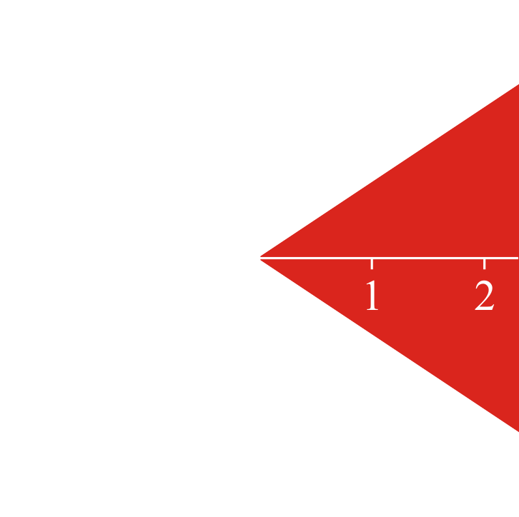
Sets
Sometimes, we will define sets through a description:
  The set of all 3-dimensional complex vectors where each
  entry has an absolute value |z| < 1
Sometimes it will be through an image:

Slide 6
Discrete signals
I may have a description as follows:
  The set of all discrete signals that are bounded
    That is, the values never exceed some fixed value in absolute value
    Note that the zero vector for discrete signals is bounded:

Slide 7
Discrete signals
We may denote a set by an italicized capital Latin letter:
  The set S of all students at the University of Waterloo
  The set T of all graduates of secondary schools in Ontario
  The set U of all complex numbers |z| ≤ 1
  The set W of all 3-dimensional vectors with all non-negative
  entries
If we are discussing an arbitrary vector space,
we may use a script U or V

Slide 8
Subsets
Given two real numbers α and β, the relationship α ≤ β may
or may not be true for two such values
  The relation tells us how the two values may be related
  to each other
Definition
One set S is said to be a subset of another set T if every
element in S is also in T
  This is written as
  Note that for all real numbers α ≤ β, at least one of
  α ≤ β or β ≤ α must be true
  However, it may be that and

Slide 9
Subsets
Examples include:
  Given the real numbers
    All positive real numbers
    All integers
    All integer multiples of π
  Given all students at Waterloo
    All nanotechnology engineering students
    All students who pass this course
  Given all students who graduated from Ontario secondary schools
    All students here are not a subset of this larger set

Slide 10
Subsets
In this course, we will always be speaking of subsets of a
given vector space
  We may then ask if and how two subsets are related
  Generally, subsets will be described with a formula
    All linear combinations of the two vectors
    All vectors of the form where α is any real value

Slide 11
Disjoint subsets
If two subsets of a given set have no entries in common,
we will say that those two subsets are disjoint
  For example,
    The irrational numbers and the integers are disjoint subsets
    of the real numbers
    Given a vector space V, if two subsets both contain the
    zero vector 0, then those subsets are not disjoint

Slide 12
Summary
Following this topic, you now
  Understand the definition of a set
  Understand the definition of a subset and disjoint
  Are aware of how these will be used in this class

Slide 13
References
[1] https://en.wikipedia.org/wiki/Set_(mathematics)
[2] https://en.wikipedia.org/wiki/Subset

Slide 14
Acknowledgments
Tina Hanna for pointing out an error in a slide.
Mac Qiu for pointing out I used “parentheses” when I meant “braces.”

Slide 15



Colophon
These slides were prepared using the Cambria typeface. Mathematical equations use Times New Roman, and source code is presented using Consolas.
The photographs of flowers and a monarch butter appearing on the title slide and accenting the top of each other slide were taken at the Royal Botanical Gardens in October of 2017 by Douglas Wilhelm Harder. Please see
https://www.rbg.ca/
for more information.

Slide 16
Disclaimer
These slides are provided for the ne 112 Linear algebra for nanotechnology engineering course taught at the University of Waterloo. The material in it reflects the authors’ best judgment in light of the information available to them at the time of preparation. Any reliance on these course slides by any party for any other purpose are the responsibility of such parties. The authors accept no responsibility for damages, if any, suffered by any party as a result of decisions made or actions based on these course slides for any other purpose than that for which it was intended.

